Slide 1
A Causal Debiasing Framework for Unsupervised Salient Object Detection
S.JAI HARISH
M.TECH-AI
CB.EN.P2AIE22013

Slide 2
INTRODUCTION
Unsupervised Salient Object Detection (USOD) is a promising yet challenging task that aims to learn a salient object detection model without any ground-truth labels
Salient object means to localize important object from an Image,In terms of human eye perspective
Framing an Causal Bayesian network to debias the contrast distribution and spatial distribution bias

Slide 3
Abstract
Selfsupervised learning based methods have achieved remarkable success recently and have become the dominant approach in USOD.
we observed that two distribution biases of salient objects limit further performance improvement of the USOD methods, namely, contrast distribution bias and spatial distribution bias
We propose a causal based debiasing framework to disentangle the model from the impact of such biases
we use causal intervention to perform deconfounded model training to minimize the contrast distribution bias and propose an image-level weighting strategy that softly weights each image’s importance according to the spatial distribution bias map

Slide 4
Salient distribution bias
Spatial distribution bias means that the position distribution of all salient objects in a dataset is concentrated on the center of the image plane, which could be harmful to off-center objects prediction.
Contrast distribution bias
contrast distribution bias is essentially a confounder that makes images with similar high-level semantic contrast and/or low-level visual appearance contrast spuriously dependent, thus forming data-rich contrast clusters and leading the training process biased towards the data-rich contrast clusters in the data.

Slide 5
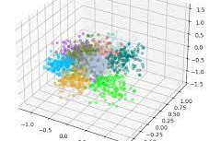
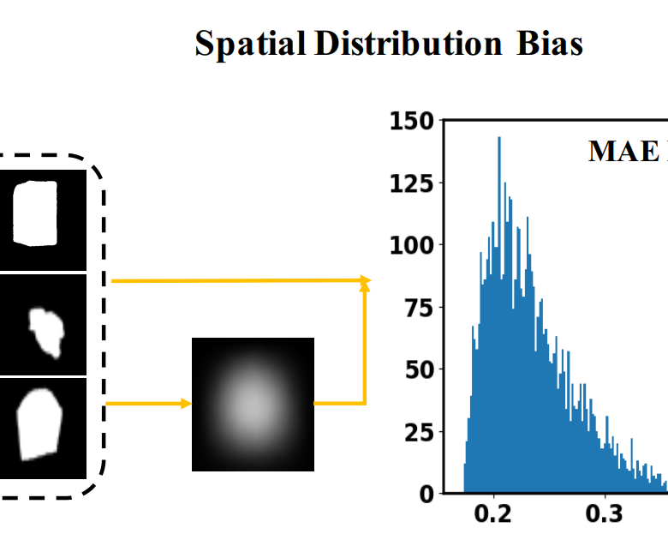
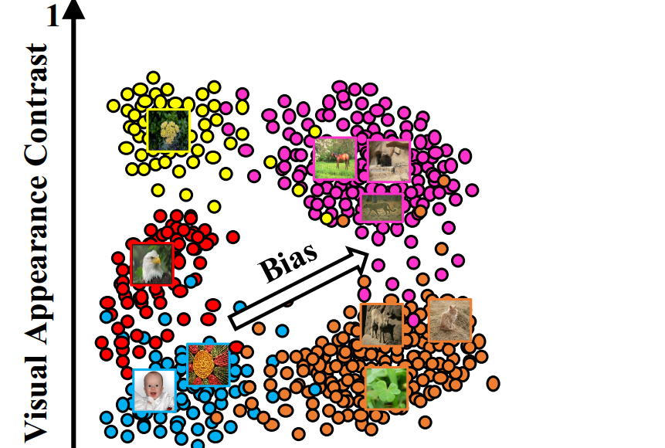

Slide 6
Two common pipeline
Traditional Deep Neural Network
Self Supervised Learning
Self-supervised learning based methods have achieved remarkable success recently and have become the dominant approach
Self-supervised training is further performed until the model performance saturates. The performance gain mainly lies in the fact that the pseudo labels contain roughly correct localization and shape of the salient objects.
we observed that the bias from the distribution of visual contrast information ( contrast distribution bias) forces the model’s training to focus on the data-rich visual contrast clusters.
The bias from the spatial distribution of salient objects (spatial distribution bias) misleads the model training towards predicting the center area of the image plane as salient.

Slide 7
A causal Inference Bayesian graph
we visually separate low- and high-level visual contrast features as described in later section in two axes
To better understand the underlying mechanism, we propose a causal graph to explain the causal effect of the contrast distribution bias
where C, R, I, and Y represent the contrast distribution, the saliency specific feature representation, the input image, and the corresponding saliency prediction, respectively.
The problem of the causal graph is that the data-rich visual contrast clusters strengthen the supervisory signals for the training of a USOD model through the causal link
I → R → Y whereas the contrast distribution confounds I and Y via the backdoor causal links I ← C → R → Y and I ← C → Y : the backdoor paths can help to correlate I and Y for some background pixels in I that are not salient at all.

Slide 8
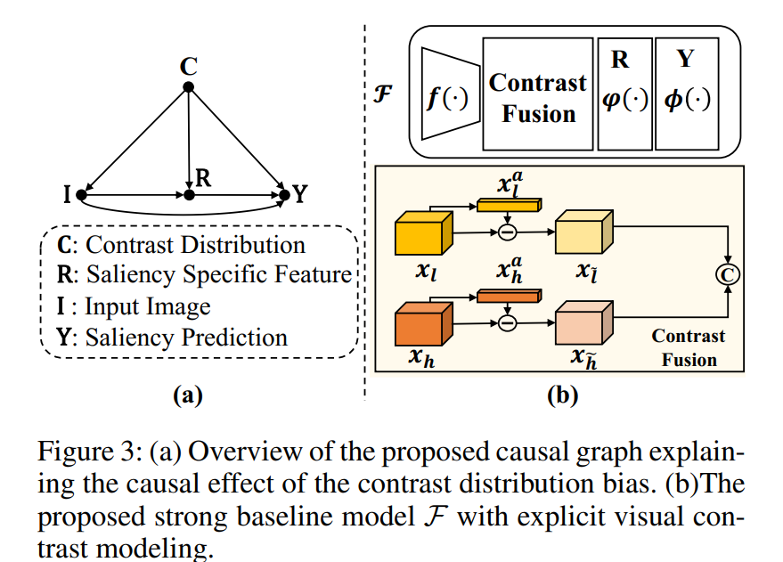
P
R
O
P
O
S
E
D
M
E
T
H
O
D

Slide 9
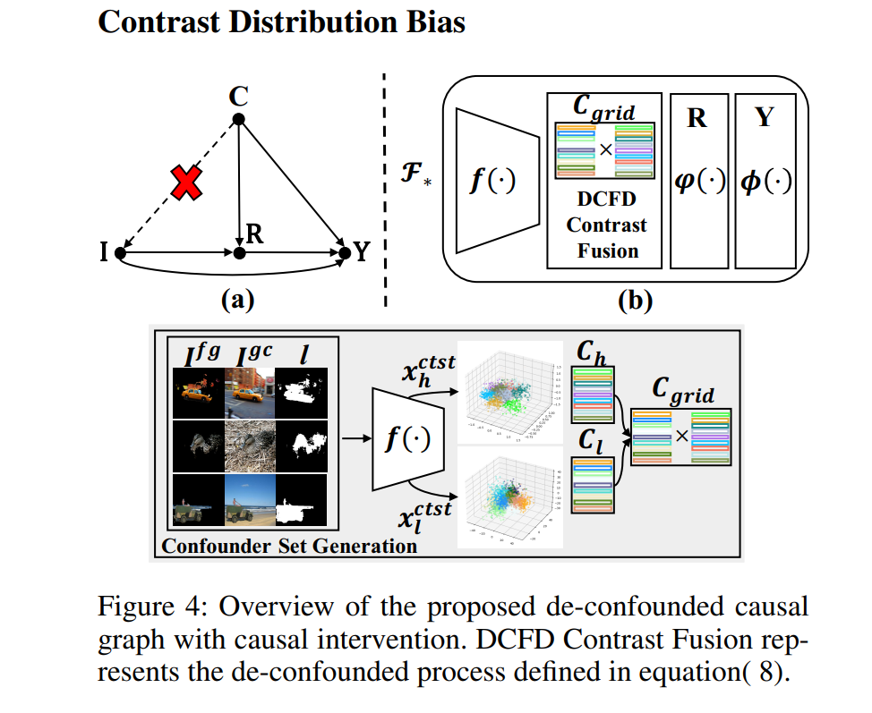

Slide 10
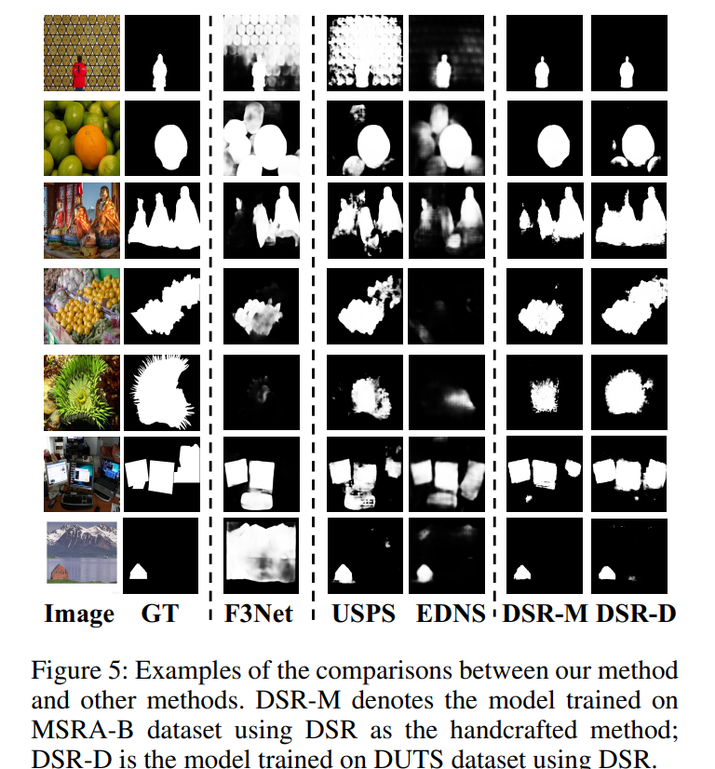

Slide 11
Here are some steps you can follow to implement a causal debiasing framework for unsupervised salient object detection:
Prepare the data: You need to have a dataset of images and their corresponding ground-truth saliency maps.You can use any standard dataset for this task, such as MSRA-B, DUT-OMRON, or PASCAL-S.
Preprocess the data: Perform any necessary preprocessing steps on the data, such as resizing, normalization, and augmentation.
Define the causal graph: You need to define the causal graph that models the relationships between different objects and their saliency. You can use a graph neural network or any other suitable technique to do this.
Train the model: Train the model using the preprocessed data and the causal graph. You can use any standard deep learning framework, such as PyTorch or TensorFlow, for this task.
Evaluate the model: Evaluate the performance of the model on a separate test set. You can use metrics such as F1 score, precision, recall, or AUC to assess the accuracy of the model.

Slide 12
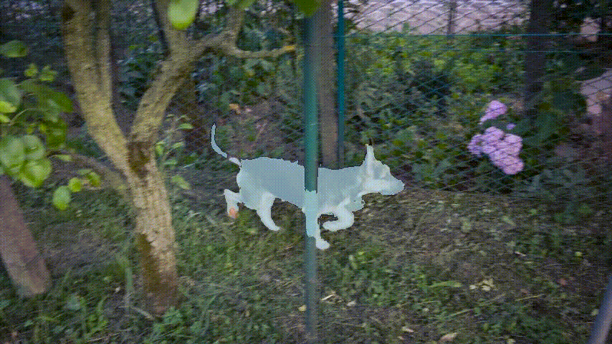
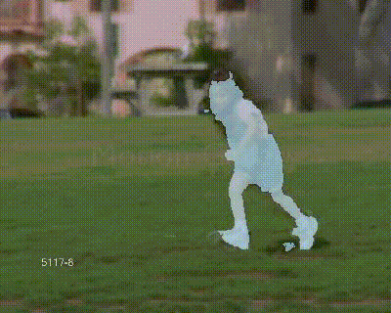
Sample Output Image

Slide 13
Thank you

